Slide 1

Selenium Testing
Abhishek Srivastava
V. Surya Kumar
Vishesh Bhadauria

Slide 2
Introduction
Selenium is a free (open-source) automated testing framework used to validate web applications across different browsers and platforms. You can use multiple programming languages like Java, C#, Python etc to create Selenium Test Scripts. Testing done using the Selenium testing tool is usually referred to as Selenium Testing.

Slide 3
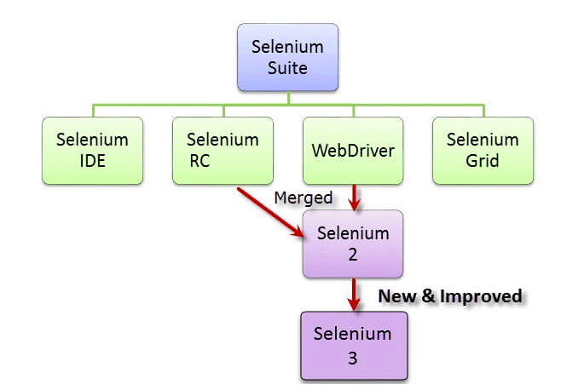

Slide 4
Brief Introduction WebDriver
The WebDriver proves itself to be better than both Selenium IDE and Selenium RC in many aspects. It implements a more modern and stable approach in automating the browser’s actions. WebDriver, unlike Selenium RC, does not rely on JavaScript for Selenium Automation Testing. It controls the browser by directly communicating with it.
The supported languages are the same as those in Selenium RC.
Java
C#
PHP
Python
Perl
Ruby

Slide 5
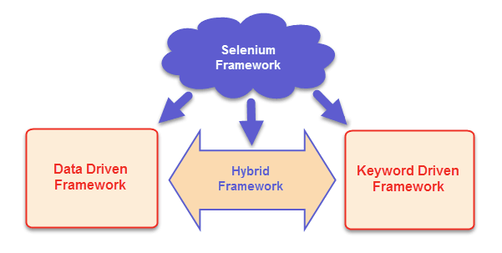
What is Selenium Framework?
The Selenium Framework is a code structure that makes code maintenance easy and efficient. Without frameworks, users may place the “code” and “data” at the same location which is neither reusable nor readable. Frameworks produce beneficial outcomes like increased code reusability, higher portability, reduced cost of script maintenance, better code readability, etc.

Slide 6
Selenium Limitations
Selenium does not support automation testing for desktop applications.
Selenium requires high skill sets in order to automate tests more effectively.
Since Selenium is open source software, you have to rely on community forums to get your technical issues resolved.
We can't perform automation tests on web services like SOAP or REST using Selenium.
We should know at least one of the supported programming languages to create tests scripts in Selenium WebDriver.

Slide 7
Implementation
Python Script using selenium to test an Website (here: Instagram).
To test the login credentials i.e. Username and Password.
To scrap the following of the user to make sure it matches with the list in the database.
Live Demonstration

Slide 8
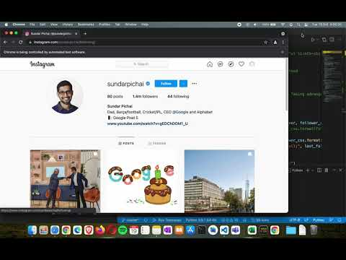

Slide 9

Thank You
Team Details:
- Abhishek Srivastava
- V. Surya Kumar
- Vishesh Bhadauria

